Slide 1
Descartes’ Correspondence in Digital Format
Circulation of Knowledge Project (CKCC)
Huygens ING, KNAW
Descartes Centre, UU
DANS, KNAW
KB

Slide 2
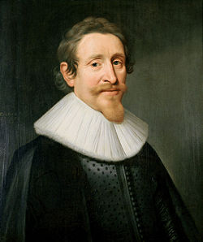
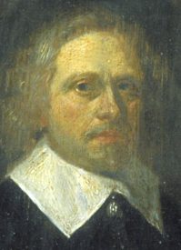
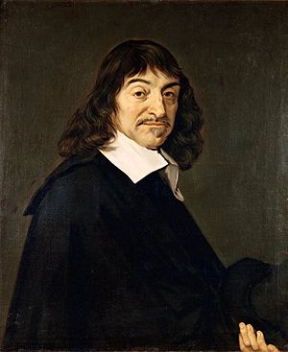
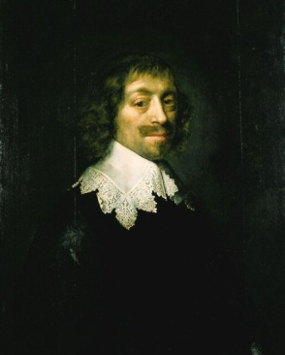
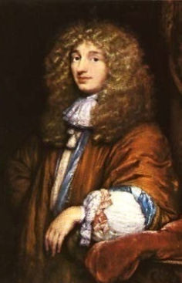
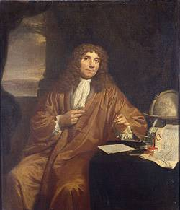
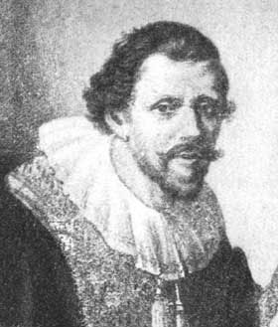
Circulation of Knowledge and Learned Practices
in the 17th century Dutch Republic. A web-based Humanities’ Collaboratory of Correspondences
Hugo
Grotius
1583-1645
Caspar
Barlaeus
1584-1648
René
Descartes
1596-1650
Constantijn
Huygens
1596-1687
Christiaan
Huygens
1629-1695
Antoni van
Leeuwenhoek
1632-1723
Jan
Swammerdam
1637-1680
> 1.200
> 750
> 7.700
> 7.300
> 2.900
< 100
< 400

Slide 3
Circulation of Knowledge (CKCC)
Objectives
Research corpus: 20,000 letters
Multilingual, 17th century: Latin, Dutch, French,
German, Italian, Spanish, English, Greek
Analysis tools
Visualization tools
Collaboratory

Slide 4
Circulation of Knowledge (CKCC)
Analysis and Visualization Targets
Network
based on metadata (people, places, data)
Content
* digital editions
* Keyword Extraction and Topic Modelling
* Concept Modelling
http://ckcc.huygens.knaw.nl

Slide 5
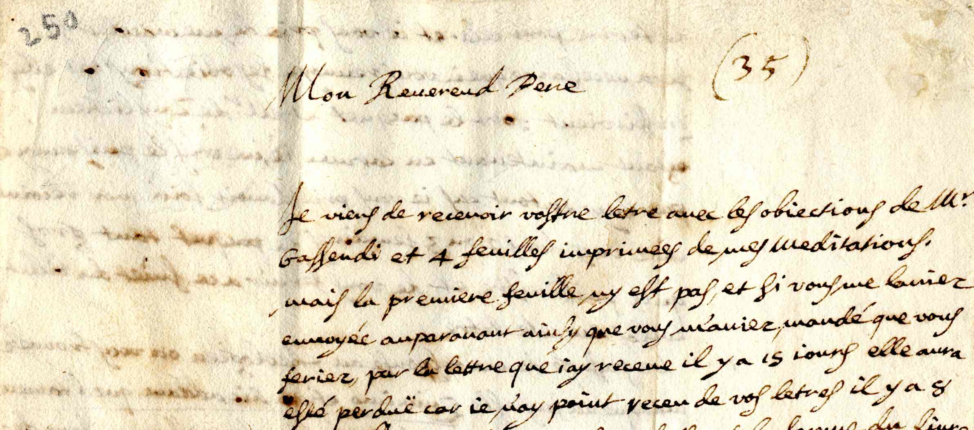
Descartes to Mersenne (Paris)Endegeest, 27 May 1641

Slide 6
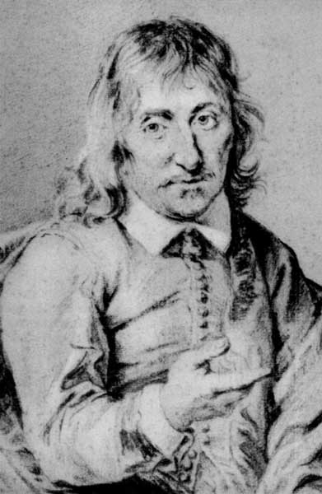
Descartes’ Correspondence
750 letters
letters from Descartes: 570 (76%)
letters to Descartes: 180 (24%)

Slide 7
Descartes’ Correspondence: Sources
Manuscript
Autograph letters
Manuscript drafts and copies
Printed
Letters (Clerselier, Lettres, 17th c.)
Testimonia (Baillet, Vie de Descartes, 1691)

Slide 8
Descartes’ Correspondence: Sources

Slide 9
Editions
Lettres de Mr Descartes, 3 vols, Paris, 1657–1667.
Claude Clerselier.
Œuvres de Descartes, 11 vols, Paris 1897–1913.
Charles Adam & Paul Tannery.
Letters in vols 1–5, 10.
Reprinted with additions and corrections, 1964–1971.
Pocket edition in 1996.
Correspondance de Descartes, 8 vols, Paris, 1936–1963.
Charles Adam & Gérard Milhaud.
Œuvres Complètes, electronic edition, 2001. [AT]
André Gombay et al. InteLex Past Masters.

Slide 10
Digital Edition for CKCC
Digitized version of Adam/Milhaud by
Katsuzo Murakami, University of Tokyo
Meguru Sasaki, École normale superieure d'Hokkaido
Takehumi Tokoro, University of Chyuo
1998.

Slide 11
Desired TEI Encoding (metadata)
<TEI>
<teiHeader>
<meta type="id" value="0084"/>
<meta type="date" value="1650-08-02"/>
<meta type="sender" value="huyg003"/>
<meta type="recipient" value="huyg007"/>
<meta type="senderloc" value="denha004"/>
<meta type="recipientloc" value="?"/>
<meta type="language" value="fr"/>
</teiHeader>

Slide 12
Desired TEI Encoding (body)
<text>
<body>
<opener>
<p>Monsieur,</p>
</opener>
<p>Nous n'avons pas receu de vos nouvelles la sepmaine passée, ...</p>
<p>Mais si d'avanture vous ne le scavez pas encore nij aucune chose ...
I'espere que vous en ferez de mesme et croirez que je demeure</p>
<closer>
<p>Vostre Tresaffectioné frere et serviteur Chr. Huijgens.</p>
</closer>
</body>
</text>
</TEI>

